Slide 1





YouHELP.US
Most modern HELP-SHARING STARTUP

Slide 2

YouHELP.US
Seek for help
Help someone in need
Monitoring your family members
Monitoring health elements
Recommend actions based on current events (bad weather, bad health)
Update to date medical history

Slide 3
YouHELP.US
Web application
Mobile application (android)
Backend development

Slide 4
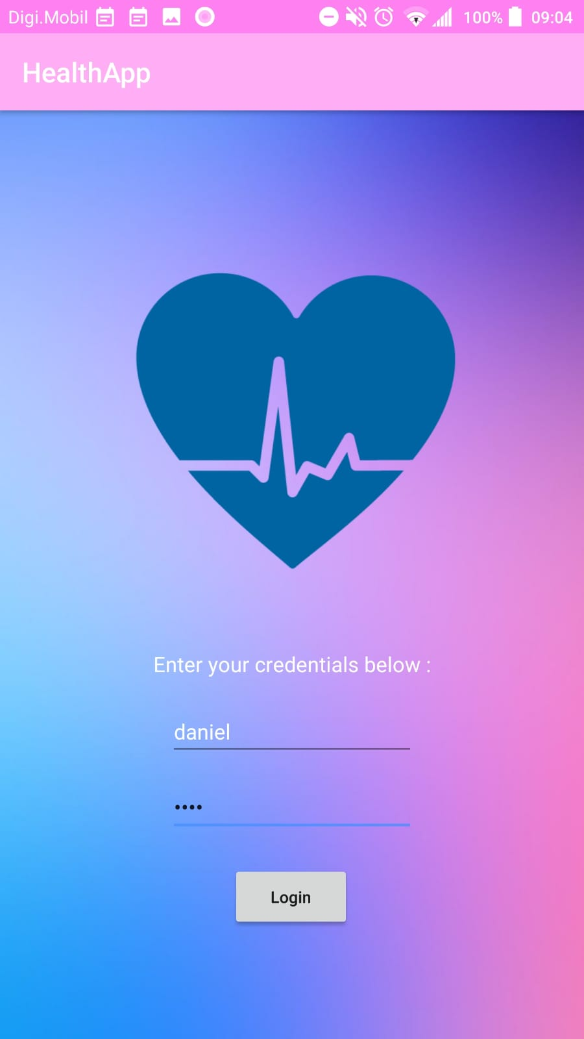
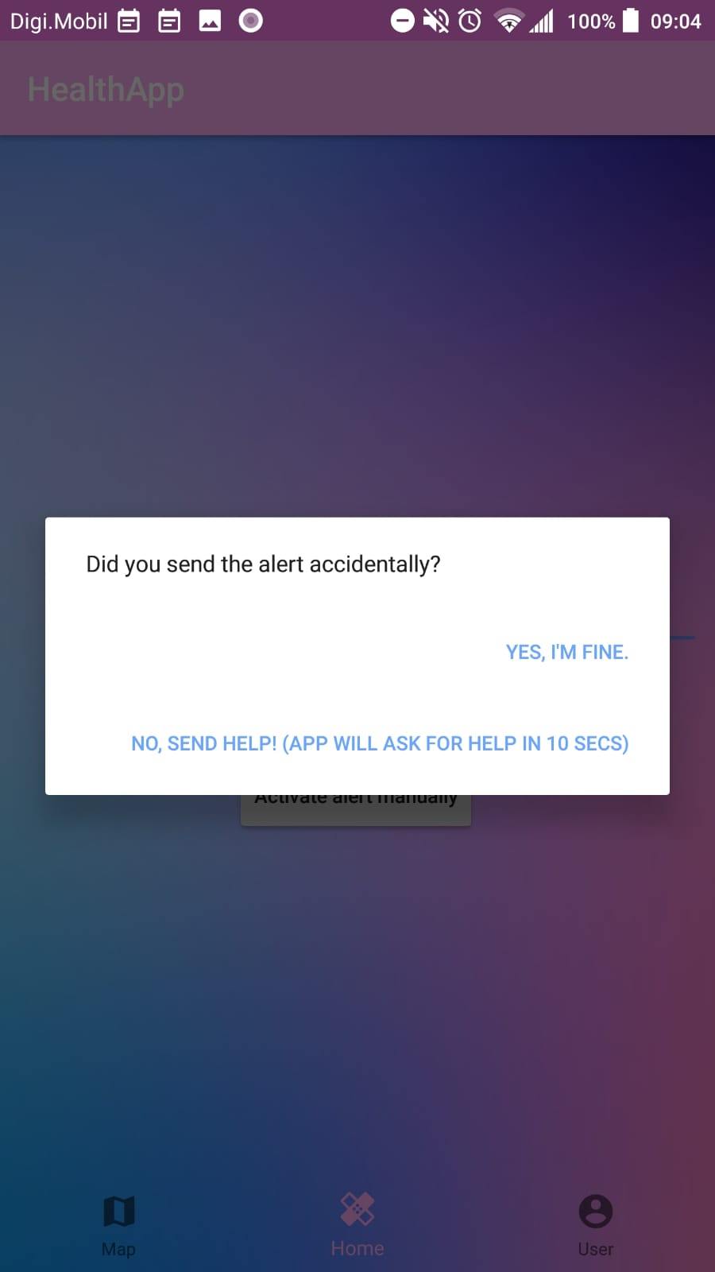
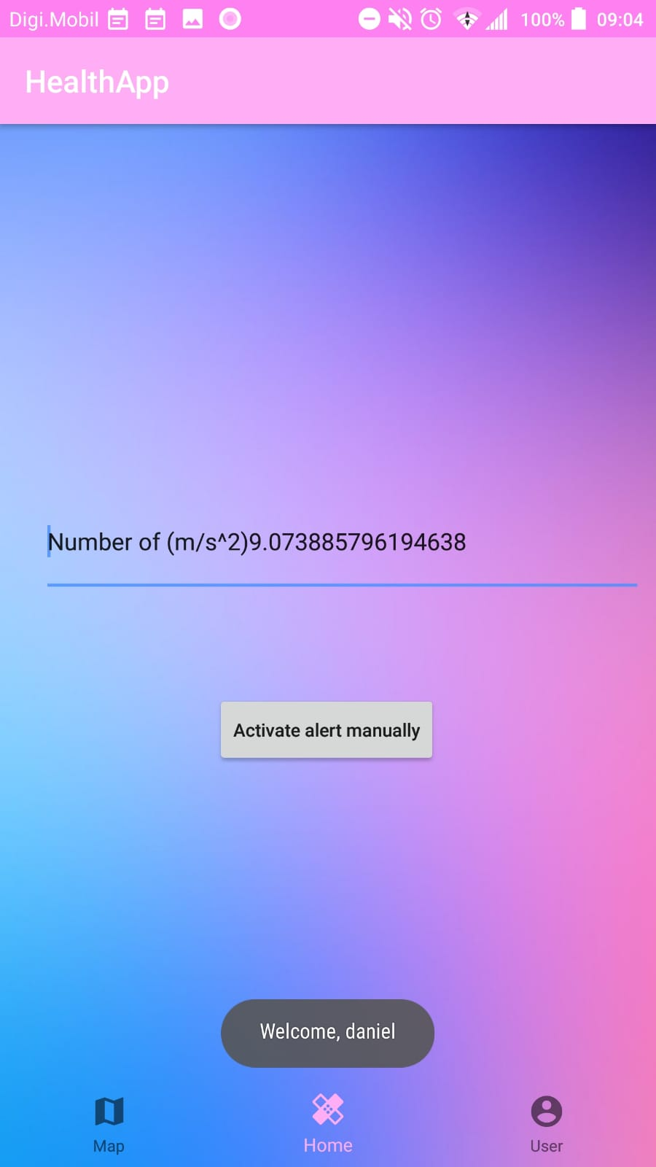
YouHELP.US

Slide 5
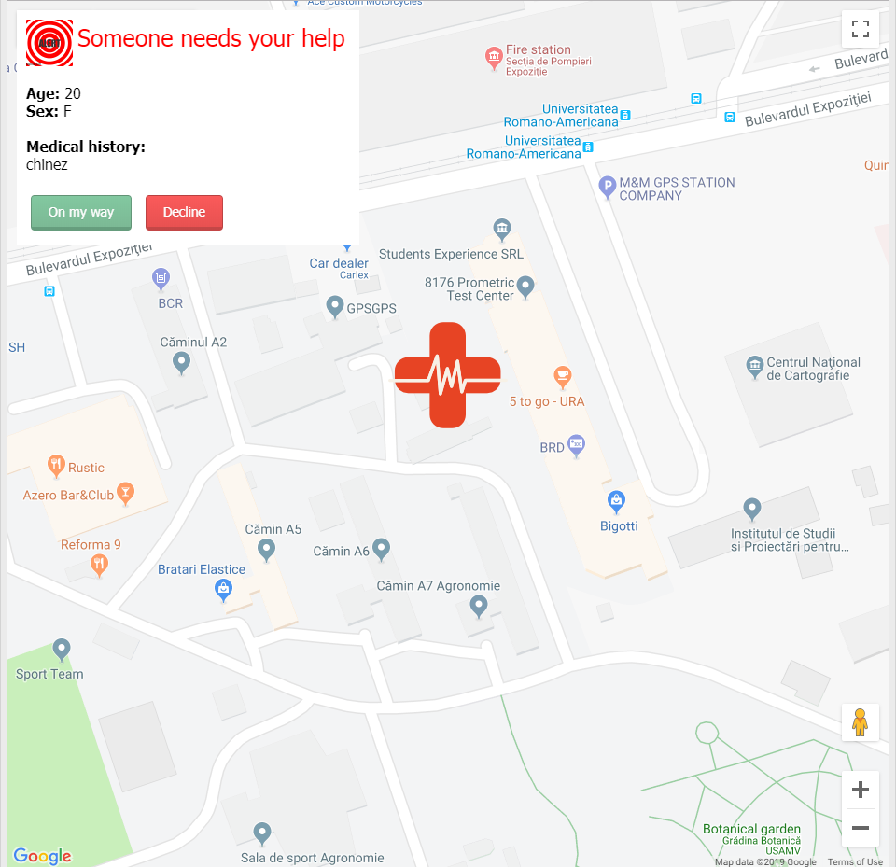
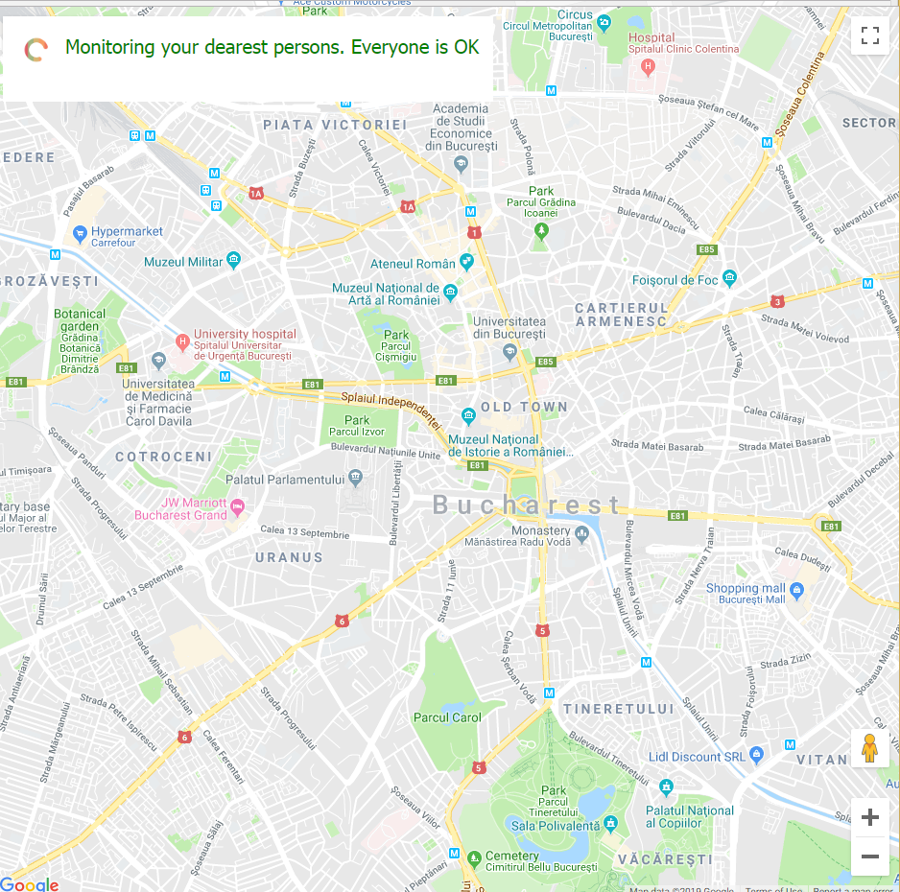
YouHELP.US

Slide 6
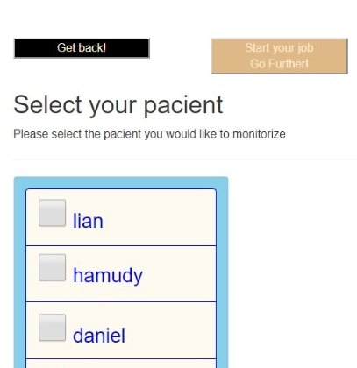
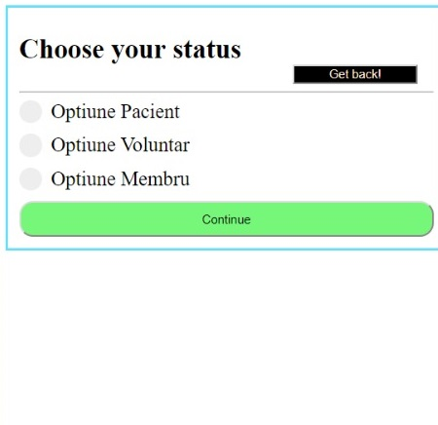
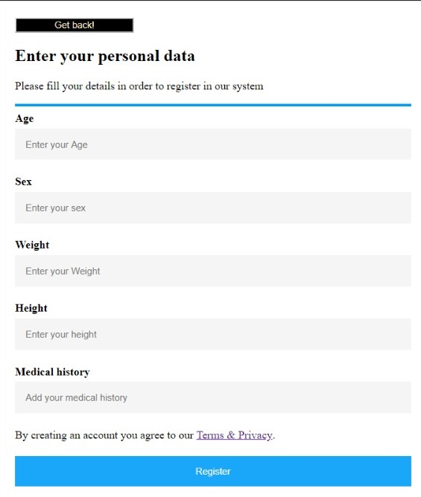
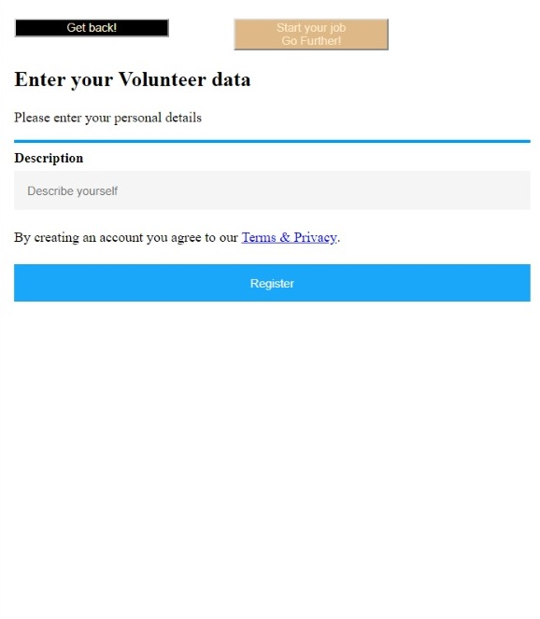
YouHELP.US

Slide 7
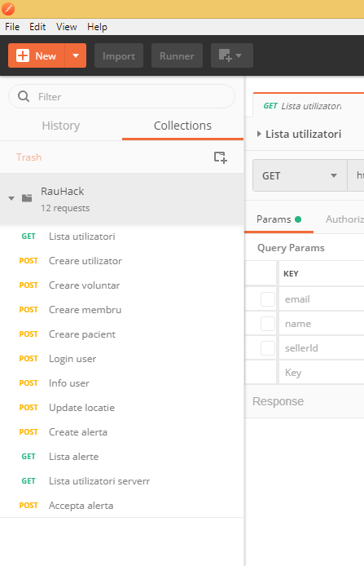
YouHELP.US

Slide 8


OtherS did it with

Slide 9
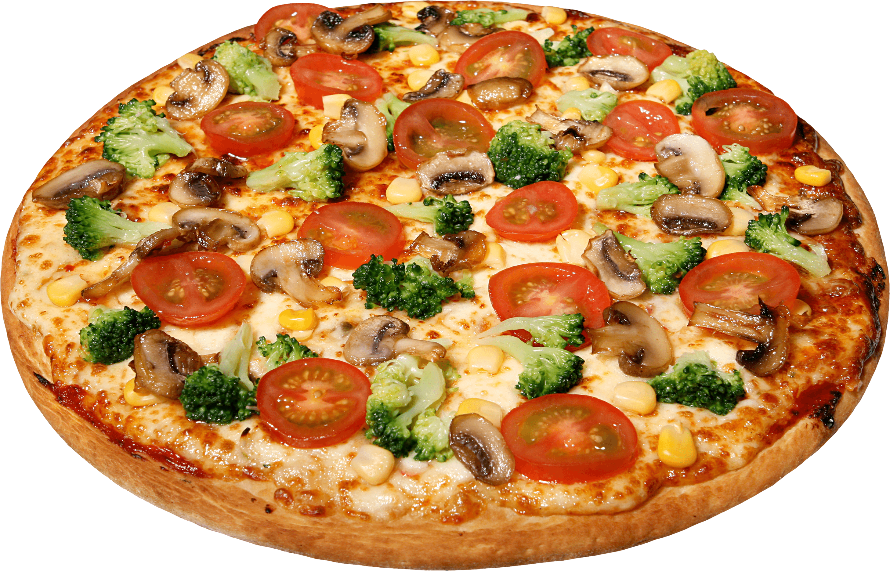
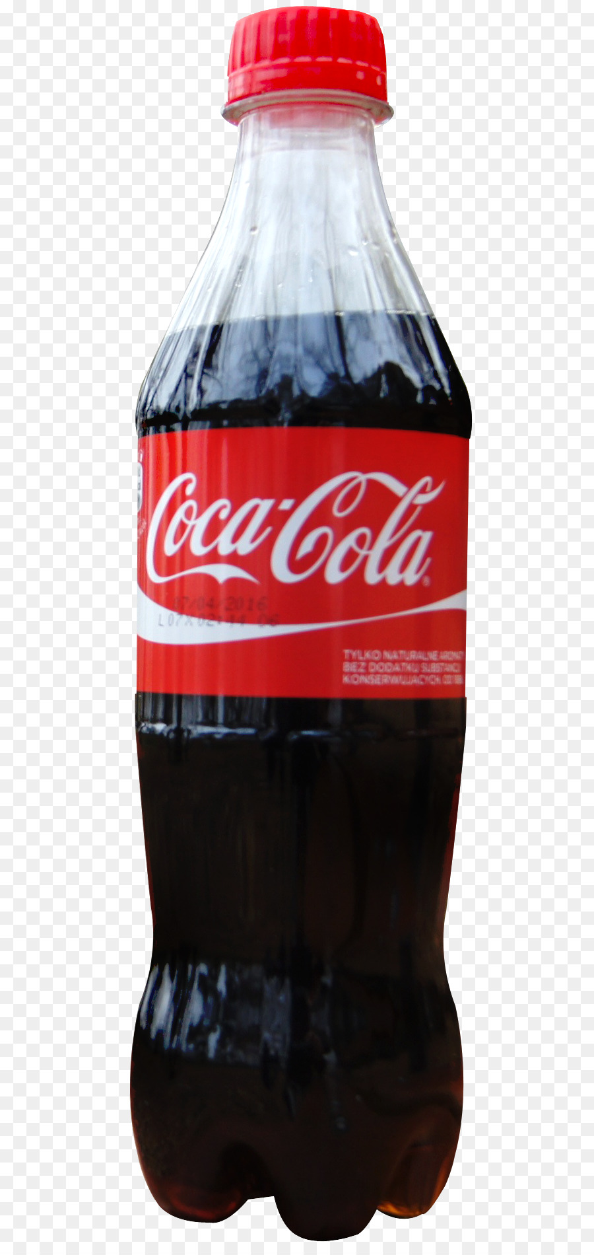

We did it with

Slide 10
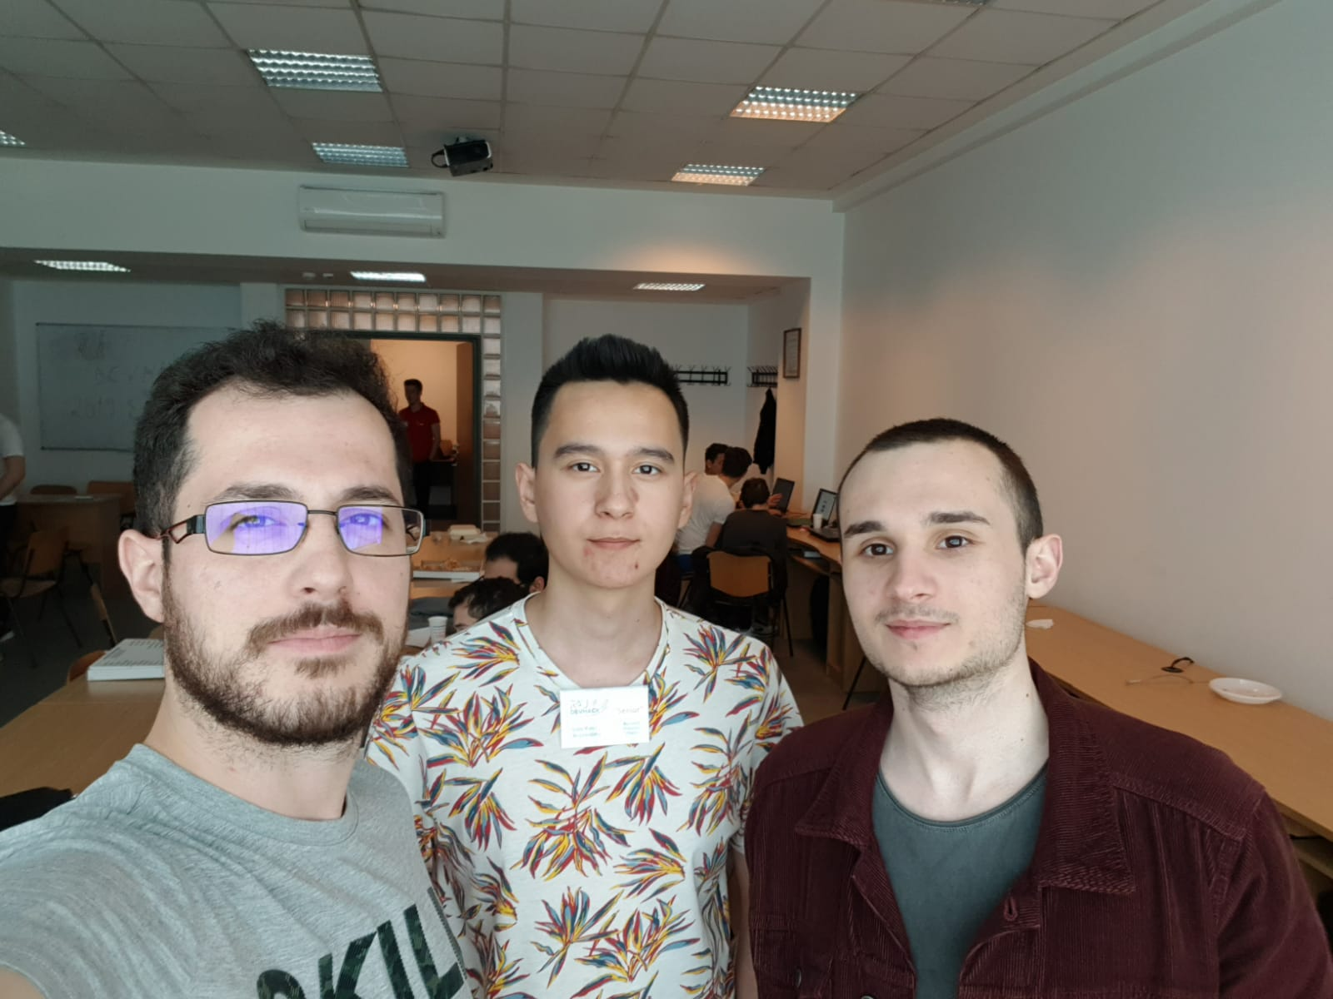
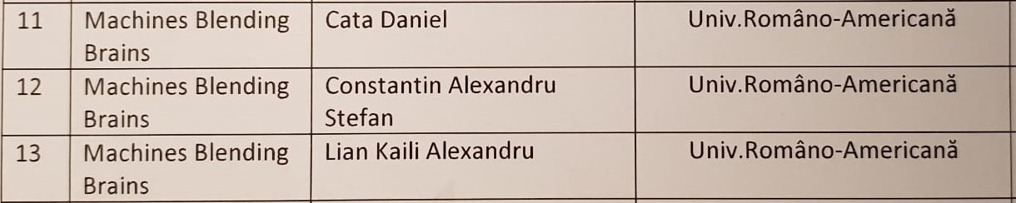
Machines blending brains

Slide 11
YouHELP.US Thank you!

